Slide 1


Bioinformatics
Gib Hemani

Slide 2
GWAS
Variants are used for
Prediction
Understanding biology

Slide 3
Outline
Fine mapping – identifying the causal variant
Identifying the causal gene
Enrichment analysis

Slide 4
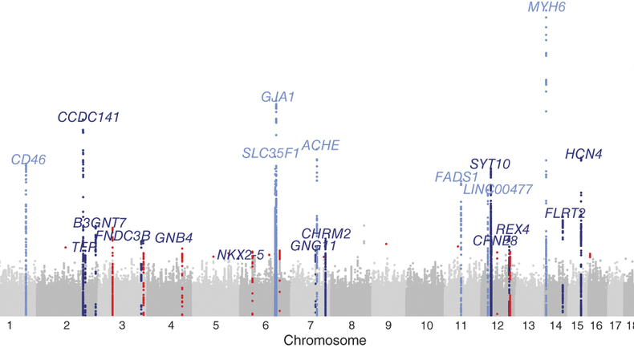
Let’s clump our GWAS hits
Notes:
The tiny perturbation of a DNA sequence leads to contribution of disease decades into the future
Posing how this happens in deterministic terms is extremely hard
How do you know which is the causal variant?

Slide 5
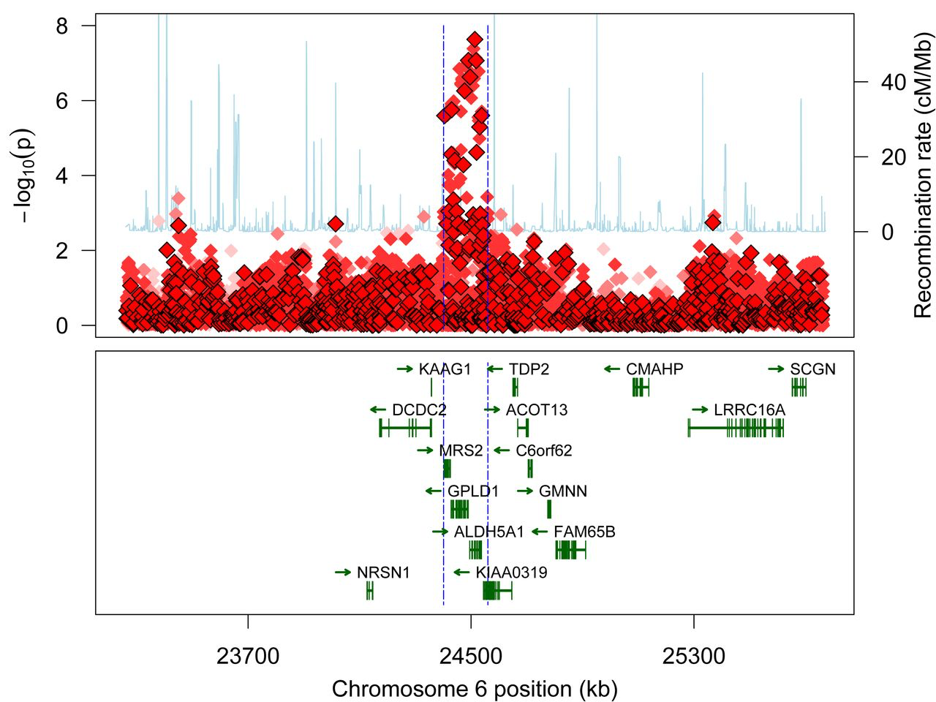
Clumping – keep one top SNP per locus
Notes:
Find the best SNP, remove everything that has R^2 over some threshold within a specified window. Typically remove any SNP with R^2 > 0.1 within 1Mb window. Anything that remains above the threshold will be retained
Why clumping? Most causal variants have LD with lots of SNPs. Every LD SNP is essentially ‘double counting’ the effect of the causal variant.

Slide 6
Quick tour of the UCSC genome browser
Notes:
Genic features
Annotations
SNPs that have previously been identified in GWAS
Reported mRNA
DNase1 hypersensitivity
Evolutionary conservation
Comparison to other animals
Variants

Slide 7
Gene Ontology (GO) terms
Maintain and develop a controlled vocabulary of gene and gene product attributes
cellular component, the parts of a cell or its extracellular environment;
molecular function, the elemental activities of a gene product at the molecular level, such as binding or catalysis;
biological process, operations or sets of molecular events with a defined beginning and end, pertinent to the functioning of integrated living units: cells, tissues, organs, and organisms.
Notes:
This is not always reliable! Work in progress. Anecdote about genes with immune function names being implicated in brain disease now…

Slide 8
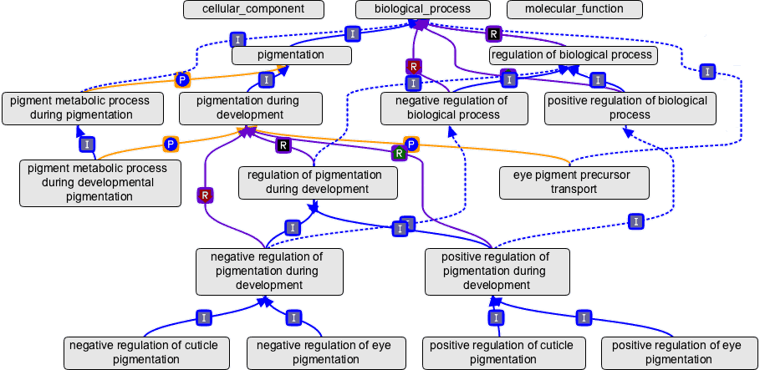
Gene Ontology (GO) terms
E.g. A gene could be annotated with no GO terms or many go terms depending on what information is available for it
Thousands of GO terms exist, e.g.

Slide 9
Kyoto Encyclopedia of Genes and Genomes (KEGG)
Systems information
PATHWAY — pathway maps for cellular and organismal functions
MODULE — modules or functional units of genes
BRITE — hierarchical classifications of biological entities
Genomic information
GENOME — complete genomes
GENES — genes and proteins in the complete genomes
ORTHOLOGY — ortholog groups of genes in the complete genomes
Chemical information
COMPOUND, GLYCAN — chemical compounds and glycans
REACTION, RPAIR, RCLASS — chemical reactions
ENZYME — enzyme nomenclature
Health information
DISEASE — human diseases
DRUG — approved drugs
ENVIRON — crude drugs and health-related substances
Notes:
This is not always reliable! Work in progress. Anecdote about genes with immune function names being implicated in brain disease now…

Slide 10
Regulation is key
Your genome is the same in every tissue*
Your genome is the same at all stages of the life course*
How do we get tissue or developmental specific functionality?
Regulation of gene expression
Aka epigenetics
* Ignoring somatic mutations

Slide 11
Annotation
Gene name
Gene function
GO terms
KEGG pathways
Transcription factor binding sites
Regulatory regions
Gene expression levels
Tissue specific expression
DNA conservation
Chromatin states
Etc etc etc etc

Slide 12
Why is fine mapping hard?

Slide 13
Multiple sclerosis
IFI30
Missense mutation of lysosomal enzyme that processes antigens for MHC presentation
MPV17L2
No known immune function
Fahr et al 2015

Slide 14
Why is fine mapping hard?
Faye et al 2013 (Plos Genetics):
Localization success rate decreases as the correlation between the tag and causal SNP increases.
Study selection at the tag SNP exacerbates this problem by increasing the magnitude of the association evidence at the tag SNP itself and at other neighboring SNPs in higher LD with the tag relative to the causal SNP.
Differential genotyping or imputation error between SNPs further decreases localization success rate, with or without the tag selection.
This problem can be exacerbated by increasing sample size, if genotyping accuracy at the causal SNP is lower than at neighboring SNPs.

Slide 15
P values are a function of…
Effect size
Sample size
Allele frequency
V_{A} = 2p(1-p)a²
If the causal variant has not been genotyped, and is in LD with the tag SNP, then
V_{A(tag)}= r²2p(1-p)a²

Slide 16
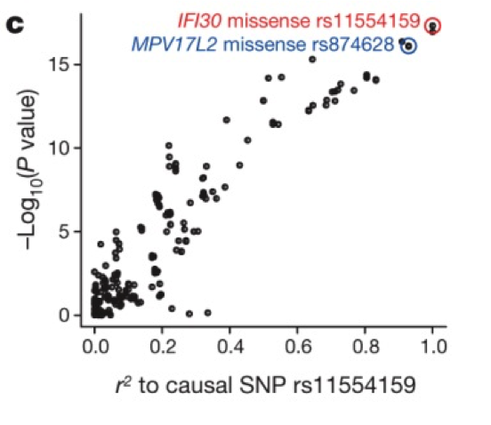
Probabilistic Identification of Causal SNPs (PICS) method
If rs11554159 is real causal variant then –log10(p) value of all other SNPs should reduce linearly as their correlation with the SNP reduces
– Farh et al 2015

Slide 17
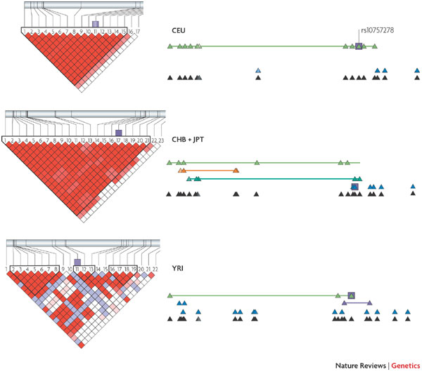
Can use differential LD patterns between different populations

Slide 18
TNFAIP3 example
Adrianto 2011 NG: Association of a functional variant downstream of TNFAIP3 with systemic lupus erythematosus
Top hit the same in Koreans and other Asians
Different in Europeans

Slide 19
TNFAIP3 – Lab work
Candidate variant (TT>A) examined in cell lines
Causes weaker binding with NF-kb complex
Results in reduced transcription of TNFAIP3
Reduced A20 protein abundance
Is this enough to declare causality for Lupus?
Notes:
NF kb is a transcription factor.

Slide 20
FTO example
UCSC shows how heavily studied this locus is
Discovered as a SNP influencing T2D in 2007
But this signal completely disappeared after adjusting for BMI
In Europeans explains 0.3% of phenotypic variance
Many variants identified independently in 46kb region of first intron
FTO: “RNA demethylase that links amino acid availability and mTORC1 signalling to regulate growth and mRNA translation”

Slide 21
FTO example
Conditional analysis only finds one SNP in the region
Can look at association in different populations to help narrow down the search
103 candidate SNPs in European populations
29 in African populations
6 are in introns…
2 predicted to influence transcription binding…

Slide 22
How does FTO influence obesity?
Prevailing hypotheses:
Changes food intake behaviour
High expression in brain
Mice with overexpression eat more
Changes in physical activity
The effect of FTO is severely attenuated amongst physically active
But FTO variant doesn’t seem to influence physical activity directly
But this is difficult to measure
Causes transcription regulation of downstream gene which influences metabolism

Slide 24
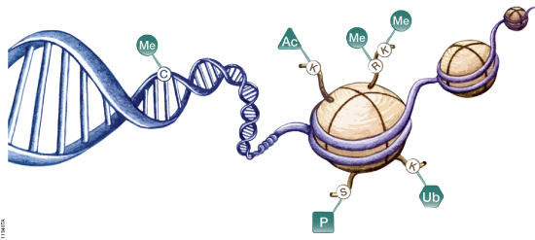
Which is the relevant tissue?

Slide 25
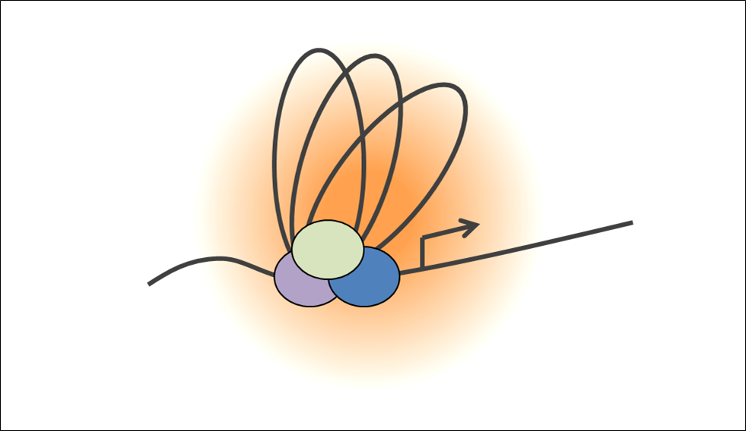
Chromatin interactions

Slide 26
Which genes are spatially related

Slide 27
Transcription factor binding sites

Slide 28
Positive energy balance
Notes:
A repressor binding motif in ARID5B is disrupted
Increased expression of IRX3/IRX5

Slide 29
Enrichment analysis
Perhaps more useful to take lots of candidate genes and see if they have something in common
Use databases and functional annotations of genes to categorise and classify them
Generate a statistic that tests how enriched the candidate genes are for a particular list of features

Slide 30
Suppose I have a list of genes…
…that were obtained from a GWAS. I annotate them with some terms from GO or KEGG or anything else. How do I know if they are enriched for a particular function?
Could simply count which terms come up most frequently in my list.
Why might I be wrong to use this metric?

Slide 31
Why might I be wrong?
Some terms might be more common than others
Chance of picking up large genes is higher than small genes
If chance of detection is higher for genes with higher LD then this might be associated with functional annotation
Allele frequency could be related to annotations (esp to do with selection) and more intermediate frequencies are easier to detect
There could be ascertainment bias on the SNP chip
Etc etc
Very important to have an appropriate null hypothesis

Slide 32
Hypothesis
I have 40000 SNPs that influence DNA methylation
Do these SNPs disproportionately influence disease?

Slide 33
Procedure
Get GWAS results for disease of interest
Extract the 40000 SNPs from that GWAS (mQTLs)
Meta analyse the p-values.
E.g. for 3 SNPs… p-vals are 0.3, 0.1, 0.01
Chisq₆ ~ -2 * ( log(0.3) + log(0.1) + log(0.01) )
Meta_pval = 0.0126
Are the p-values more extreme than we would expect by chance?

Slide 34
Problem
The mQTLs are typically found in genic regions
The mQTLs typically have high LD and high MAF
SNPs in genic regions, with high LD, and high MAF, have disproportionately large effects on disease
The null hypothesis needs to reflect this

Slide 35
Generating a distribution under the null
Choose 40000 random SNPs that are in genic regions, high LD, high MAF
Calculate meta p-value
Repeat

Slide 36
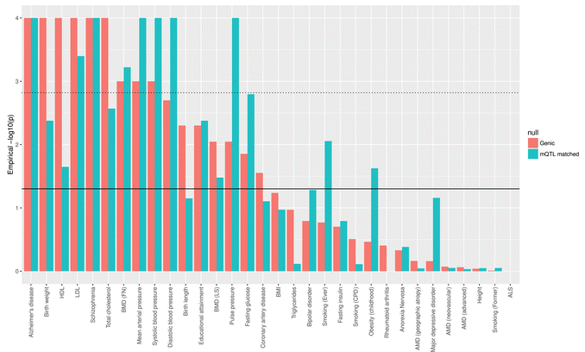
Different ‘nulls’ give different results

Slide 37
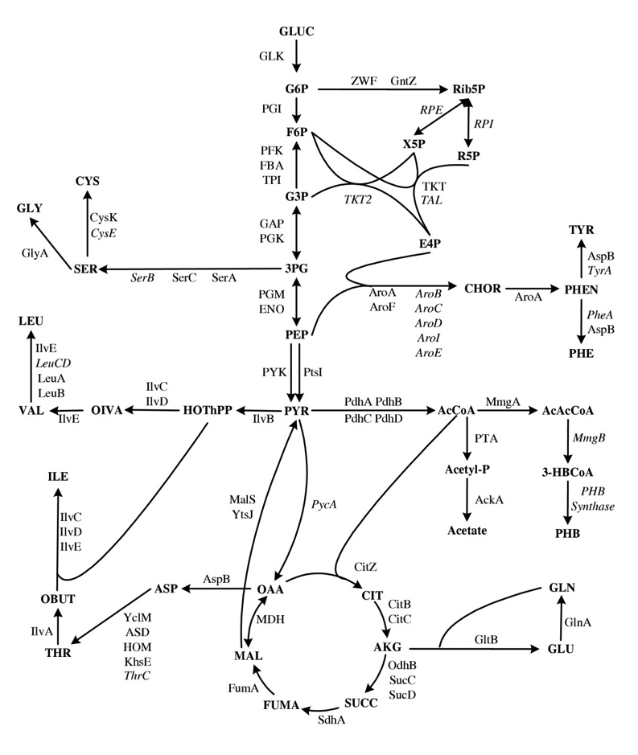
The spandrels of San Marco and the Panglossian Paradigm
Notes:
Enormous amount of information – the problem just got much more complex
Gould and Lewontin: Long been a question of what the purpose of different features are
In evolutionary biology, a spandrel is a phenotypic characteristic that is a byproduct of the evolution of some other characteristic, rather than a direct product of adaptive selection.
Trying to figure out a function is one thing, the story of adaptation is another layer of complexity

Slide 38
Summary
Going from GWAS signal to causal variant is often very difficult
Can use different populations
Functional annotation
Lab work
Enrichment analysis can provide insight into disease mechanisms
But must be careful to avoid false positives
Huge amount of data being generated to annotate genomes
Countless hypotheses can be generated and tested
The quality of the data is quite variable

Slide 39
Functional annotation
http://kn3in.github.io/annotation/ - good tutorial on using biomart in R
Haploreg http://www.broadinstitute.org/mammals/haploreg/haploreg_v3.php
Ensembl http://www.ensembl.org/info/docs/tools/vep/index.html

Slide 40
Databases
Broad Spectrum Queries
Entrez
http://www.ncbi.nlm.nih.gov/sites
GeneCards
http://www.genecards.org/
Nucleotide
GenBank
http://www.ncbi.nlm.nih.gov/Genbank
Ensembl
http://www.ensembl.org/
Mutation
HGMD (Human gene mutation database)
http://www.hgmd.cf.ac.uk
Database of Genomic Variants:
http://projects.tcag.ca/variation/
mutDB:
http://www.mutdb.org/
Mitomap (Mitochondrial DNA):
http://www.mitomap.org/
SNPs & common structural changes
1000 genomes
http://www.1000genomes.org/
ALFRED
http://alfred.med.yale.edu/alfred/index.asp
UCSC genome browser
http://genome.ucsc.edu/
dbSNP
http://www.ncbi.nlm.nih.gov/projects/SNP/
HapMap
http://hapmap.ncbi.nlm.nih.gov/

Slide 41
Databases
Genomewide association study results
Catalogue of human genomewide association studies
http://www.genome.gov/gwastudies/
Expression
NCBI
http://www.ncbi.nlm.nih.gov/
Jackson mouse laboratories
http://phenome.jax.org/
UCSC genome browser
http://genome.ucsc.edu/
Regulatory elements (miRNA)
Noncoding RNA database
http://biobases.ibch.poznan.pl/ncRNA/
The Rfam data base, Sanger
http://rfam.sanger.ac.uk/
Bioexplorer.net
http://www.bioexplorer.net/Databases/
Protein
UniProt
http://beta.uniprot.org/
PDB (Protein Data Bank)
http://www.pdb.org/pdb/home/home.do
PIR (Protein Information Resource)
http://pir.georgetown.edu/
Pfam (protein families - Sanger)
http://pfam.sanger.ac.uk/
HMPD (Human mitochondrial protein database)
http://bioinfo.nist.gov/
Linkage disequilibrium
SNAP annotation and proxy search
http://www.broadinstitute.org/mpg/snap/

